Slide 1
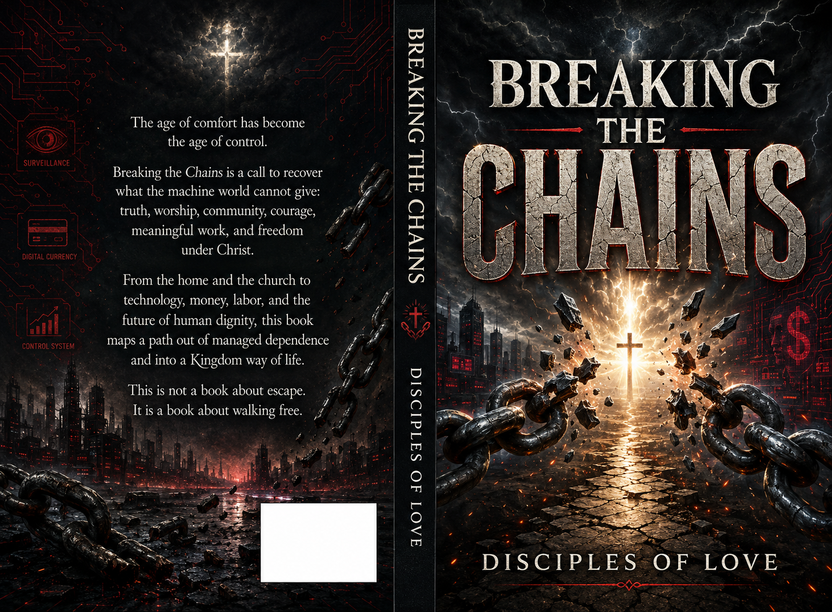

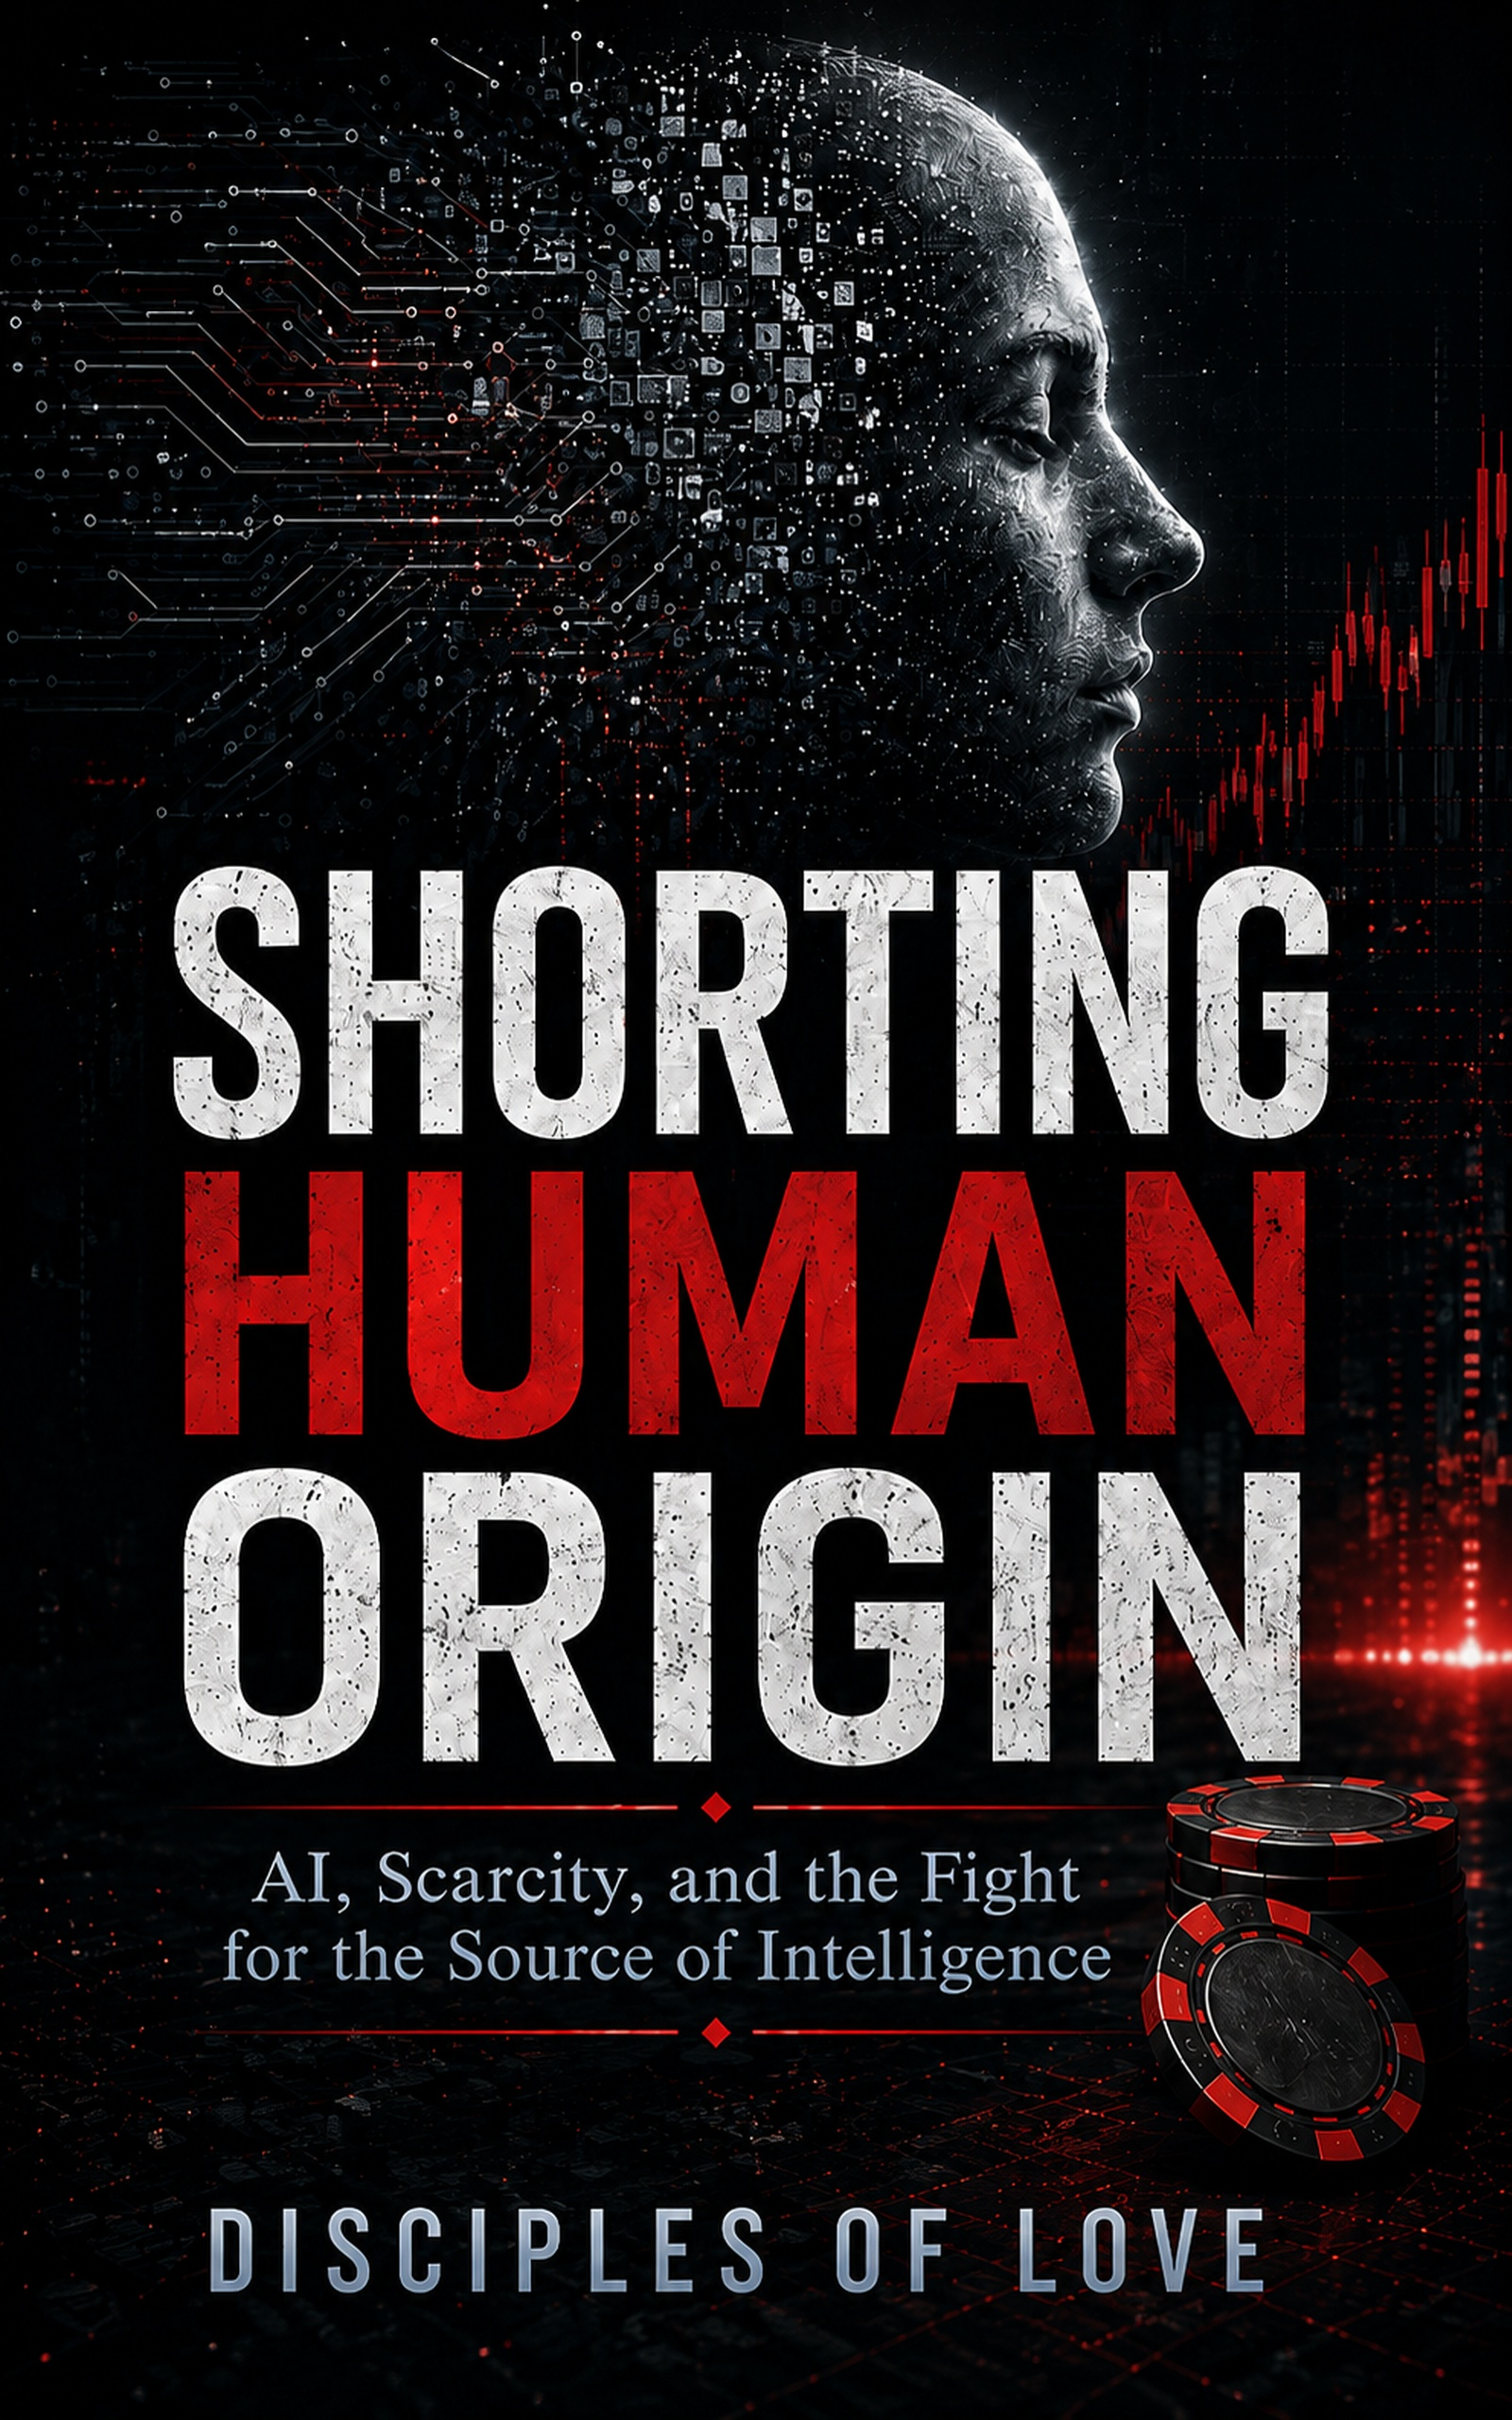
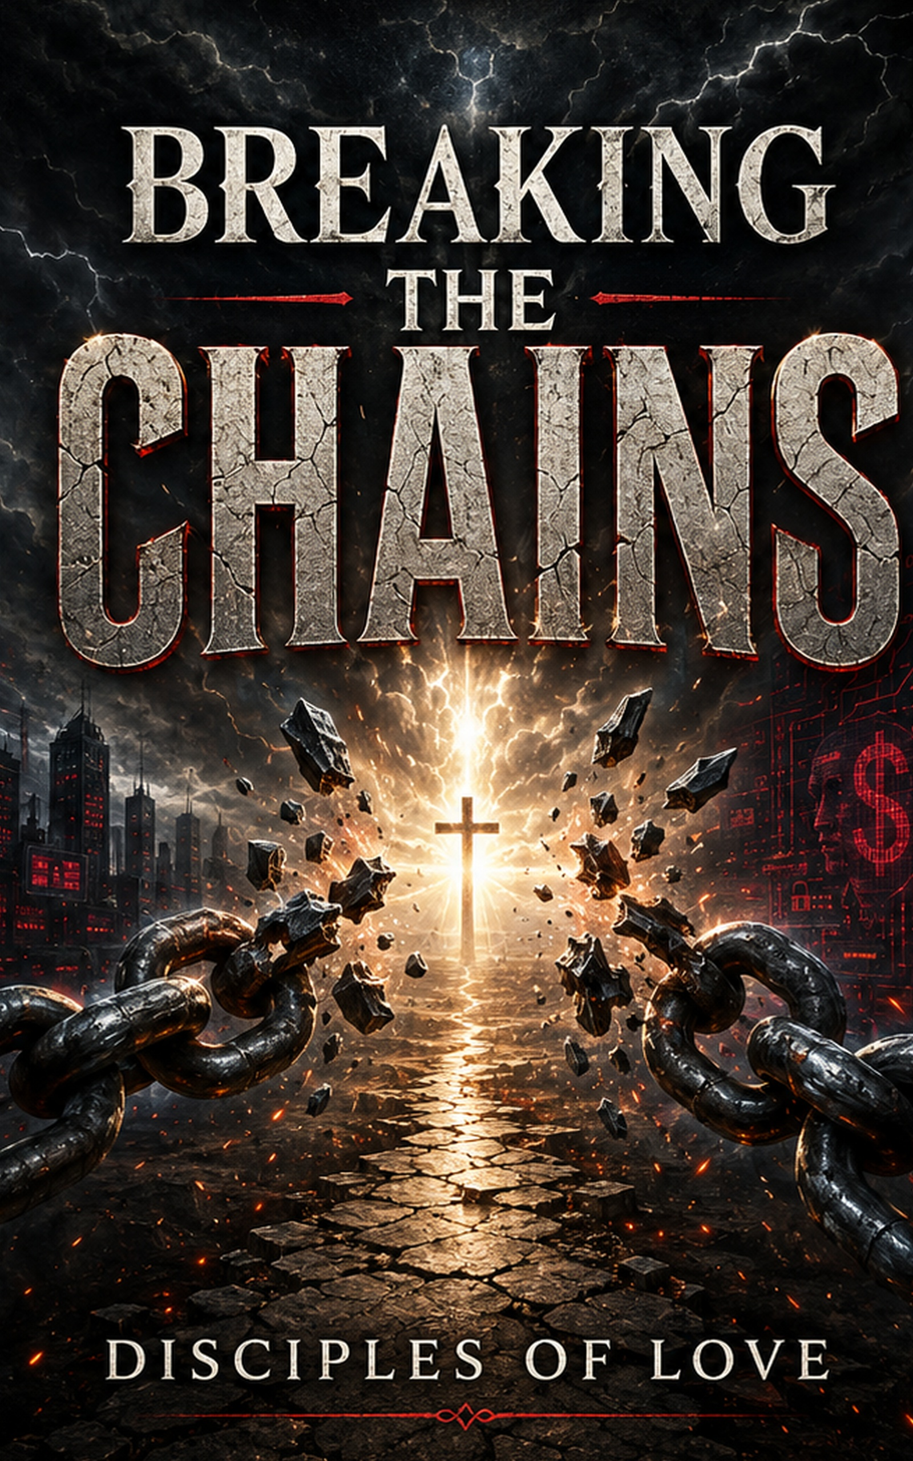
THE HUMAN ORIGIN TRILOGY
Book One names the crisis. Book Two traces the road. Book Three breaks the chains.
AI • CONTROL • HUMAN DIGNITY • KINGDOM FREEDOM
DISCIPLES OF LOVE
01

Slide 2

THE TRILOGY ARC
One warning. One road. One way out.
01
SHORTING
HUMAN ORIGIN
02
THE ROAD TO
ARMAGEDDON
03
BREAKING
THE CHAINS
The Crisis
The Road
The Liberation
Crisis → Road → Freedom
02

Slide 3
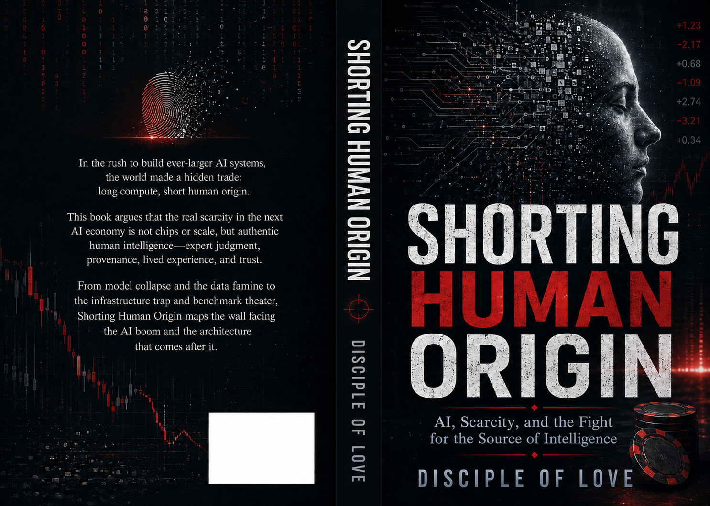
BOOK ONE NAMES THE CRISIS
AI is not running out of computation first. It is running out of origin.
SHORTING HUMAN ORIGIN
• The data famine
• Model collapse & benchmark theater
• Provenance as the new scarcity layer
• Human judgment as the source of intelligence
“Machines can imitate traces of human life — but they cannot become the source.”
03

Slide 4
BOOK TWO TRACES THE ROAD
The managed world did not appear overnight. It was built through systems.
THE ROAD TO ARMAGEDDON
• Money without mercy
• War as an operating system
• Propaganda & synthetic reality
• Digital identity and managed access
• AI as the final interface
From human dignity to human optimization.
04

Slide 5
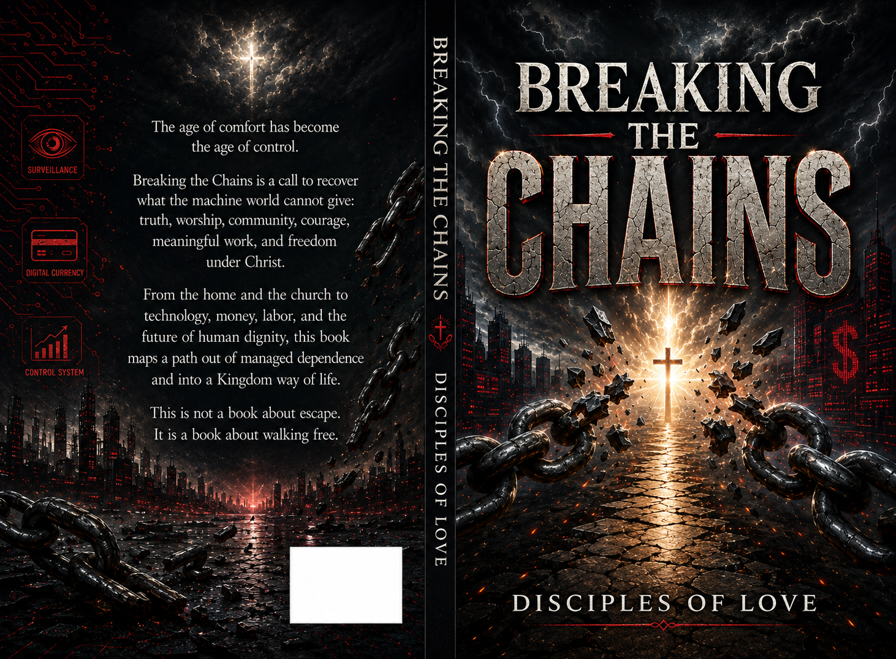
BOOK THREE BREAKS THE CHAINS
The liberation volume: not escape — walking free under Christ.
BREAKING THE CHAINS
• Fear, debt, screens, approval
• The free home and free church
• Communities of refuge
• Work without slavery
• Technology under love
“The strongest chains are the ones people defend because they no longer remember what freedom feels like.”
05

Slide 6
THE WARNING BENEATH THE TRILOGY
The books are connected by one central question: what still belongs to the human soul?
AI WITHOUT ORIGIN
THE MANAGED WORLD
SCREENS AS DISCIPLESHIP
Synthetic systems depend on human traces they cannot generate from nothing.
Convenience becomes dependency when every system requires permission.
The screen trains attention, desire, fear, identity, and reality.
MONEY WITHOUT MERCY
TECHNOLOGY UNDER LOVE
THE KINGDOM WAY OUT
Debt and financialization capture the future before it arrives.
Tools must kneel beneath dignity, Sabbath, mercy, and truth.
Freedom is allegiance to Christ and rebuilding life under God.
06

Slide 7
WHO THE TRILOGY IS FOR
Readers who can feel the age shifting — and want more than panic.
Believers & Families
Pastors & Churches
Form homes that can resist fear, screens, hurry, and false worship.
Recover the church as a body, not an audience or content brand.
Builders & Technologists
Workers & Communities
Create tools that serve dignity, agency, privacy, and love.
Build meaningful work, mutual aid, and communities of refuge.
The future will test what owns us.
07

Slide 8
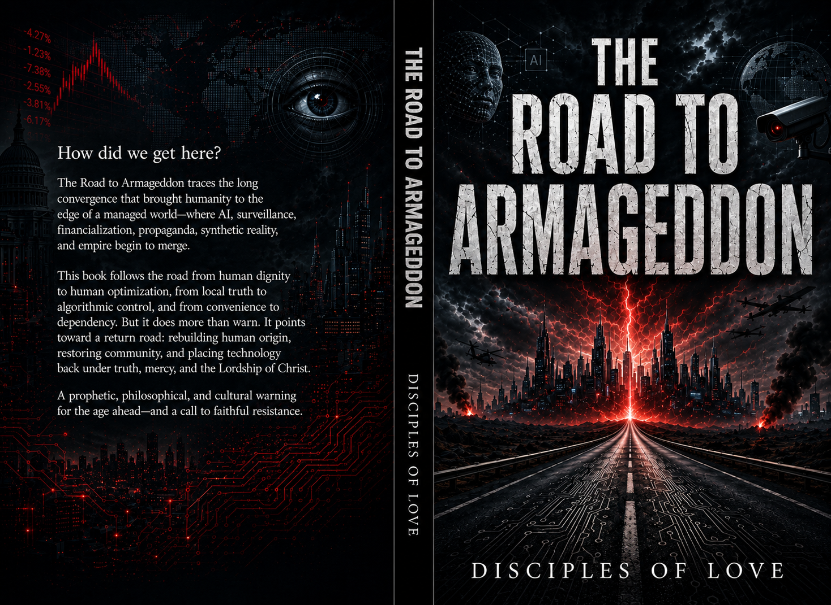
THE WAY OUT IS REBUILDING
The trilogy does not end in fear. It ends with formation.
01
Recover the Mind
02
Recover the Home
03
Recover the Church
Scripture, memory, discernment, patience, and truth.
Tables, prayer, limits, confession, blessing, and Sabbath.
A body that carries burdens and stands under pressure.
04
Recover Community
05
Recover Work
06
Recover Technology
Mutual aid, local trust, shared skills, and practical refuge.
Vocation and craft instead of slavery to debt and metrics.
Tools under love, privacy, accountability, repair, and mercy.
Freedom is not self-rule. Freedom is joyful surrender to the rightful King.
08

Slide 9
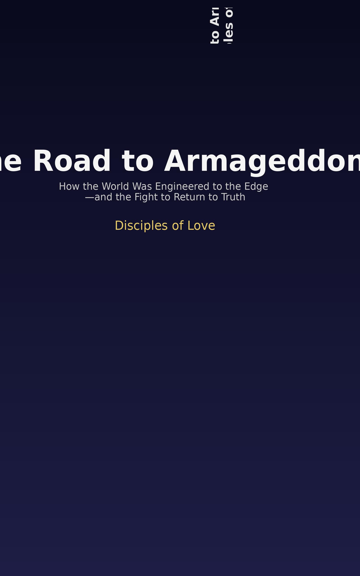
THE READER JOURNEY
A complete path from diagnosis to exodus to rebuilding.
START
CONTINUE
FINISH
Understand the AI crisis and why human origin matters.
Trace the systems that brought us to the edge.
Break the chains and rebuild life under Christ.
CRISIS → ROAD → FREEDOM
09

Slide 10
LAUNCH ECOSYSTEM
Position the trilogy as a premium brand across Amazon, the website, media, and community.
AMAZON / KDP
TRILOGY WEBSITE
Three paperback + ebook listings with consistent subtitles, keywords, and covers.
Official hub: The crisis, the road, the way out.
READER DISPATCH
PODCAST / MEDIA
Email list for essays, resources, launch updates, and book excerpts.
A clear message: AI, managed life, human dignity, and Christian freedom.
CHURCH / COMMUNITY
SOCIAL CONTENT
Reader guide, small group questions, and discussion nights.
Quote graphics, short clips, and themed carousels from each book.
10

Slide 11
THE TRILOGY IN ONE SENTENCE
Book One names the crisis.
Book Two traces the road.
Book Three breaks the chains.
Together, the trilogy is a warning and a roadmap: a call to recover human origin, resist the managed world, and rebuild life under the Lordship of Christ.
11

Slide 12
THE DOOR HAS BEEN OPENED.
Walk free.
Recover human origin. Resist the managed world. Rebuild under God.
THE HUMAN ORIGIN TRILOGY • DISCIPLES OF LOVE
12

